Slide 1
EMPLOYEE ATTRITION PREDICTION USING SUPERVISED LEARNING CLASSIFICATION ALGORITHM
Rohith SS (190801065)
Sailesh Baabu S (190801068)
Batch No :
Name of the Guide : Ms. N .UMA
Date of Review : 29/03/2023

Slide 2
PROBLEM STATEMENT
To develop a relevant employee attrition model in order to identify key employee features influencing his/her attrition
This attrition prediction is based on supervised machine learning models

Slide 3
ABSTRACT
In the era of data science and big data analytics, people analytics help organizations and their human resources (HR) managers to reduce attrition by changing the way of attracting and retaining talent.
The employee attrition presents a critical problem and a big risk for organizations as it affects not only their productivity but also their planning continuity.
We propose a analytics approach to predict employee attrition that shifts from a big data to a deep data context by focusing on data quality instead of its quantity. The deep data-driven approach is based on a mixed method to construct a relevant employee attrition model in order to identify key employee features influencing his/her attrition.

Slide 4
LITERATURE SURVEY
TOPIC | AUTHOR | SURVEY
Prediction of employee turnover in organizations using machine learning algorithms | R. Punnoose | Employee turnover has been identified as a key issue for organizations because of its adverse impact on work place productivity and long term growth strategies. To solve this problem, organizations use machine learning techniques to predict employee turnover. Accurate predictions enable organizations to take action for retention or succession planning of employees
Career abandonment intentions among software workers | R. Colomo-Palacios, C. Casado-Lumbreras | This is to discover the main motivations young practitioners abandon the software career. To achieve this objective, two studies were conducted. The first study was qualitative and intended to discover the main variables affecting software career abandonment. The second study was quantitative, consisting of a Web-based survey
HR and analytics: Why HR is set to fail the big data challenge | D. Angrave, A. Charlwood | This article takes issue with optimistic accounts, which hail HR analytics as a ‘must have’ capability that will ensure HR's future as a strategic management function while transforming organisational performance for the better.

Slide 5
PROPOSED WORK
Employee attrition prediction is tackled as a supervised learning problem, and in particular, as a binary classification one. In other words, we are interested in detecting and confirming the existence or not of the employee's intention to leave .
To do so, we have put to the test different supervised machine and deep learning techniques, using also the implementations provided in Python's library scikit-learn . In particular, we have adhered to the following classifiers: Decision Tree, Logistic Regression and Support Vector Machine (as machine learning models), Random Forest, XGBoost and Vote Classier (as ensemble learning models)

Slide 6
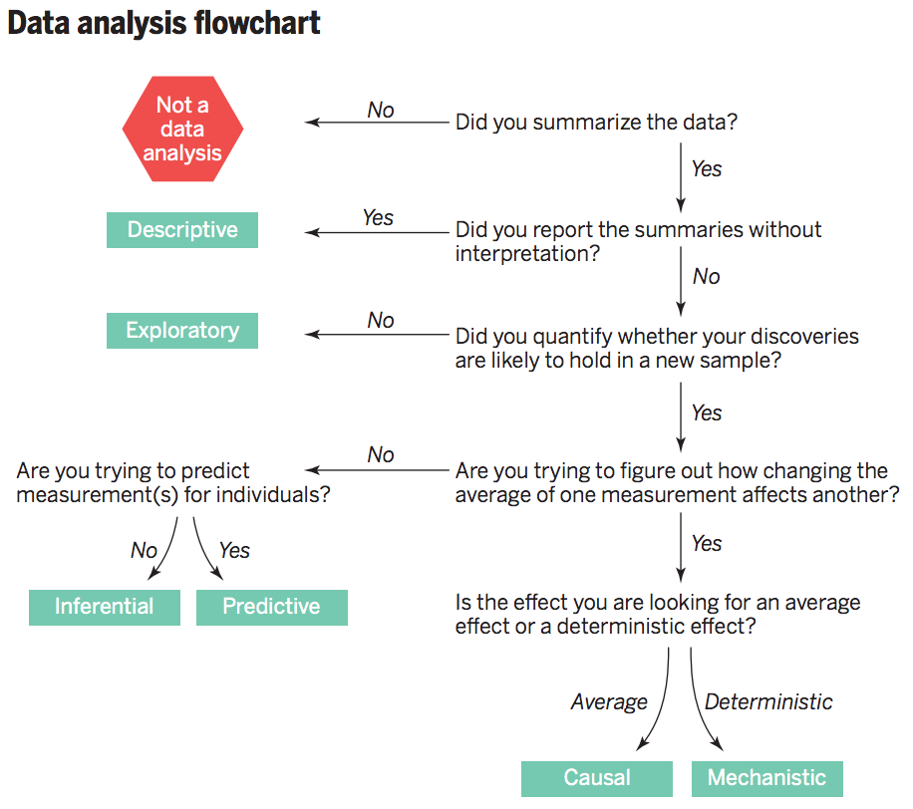
WORKFLOW DIAGRAM-1

Slide 7
WORKFLOW DIAGRAM-2

Slide 8
MODULES AND ITS DESCRIPTION
The modules and their description for this project is as follows :
MODULE - I : Data Collection
MODULE- II : Data Preparation
MODULE - III : Exploratory Data Analysis
MODULE - IV : Model Building

Slide 9
MODULE - I
Data Collection
The data is collected from the IBM simulated dataset and it contains 34 input features.
(Age,Business Travel, Daily Rate, Department, Distance From Home, Education, Education Field, Employee Count, Employee Number, Environment Satisfaction, Gender, Hourly Rate, Job Involvement, Job Level, Job Role, Job Satisfaction, Marital Status, Monthly Income, Monthly Rate, Num Companies Worked, Over18, Over Time, Percent Salary Hike, Performance Rating, Relationship Satisfaction, Standard Hours, Stock Option Level, Total Working Years, Training Times Last Year, Work Life Balance, Years At Company, Years In Current Role, Years Since Last Promotion, Years With Current Manage)

Slide 10
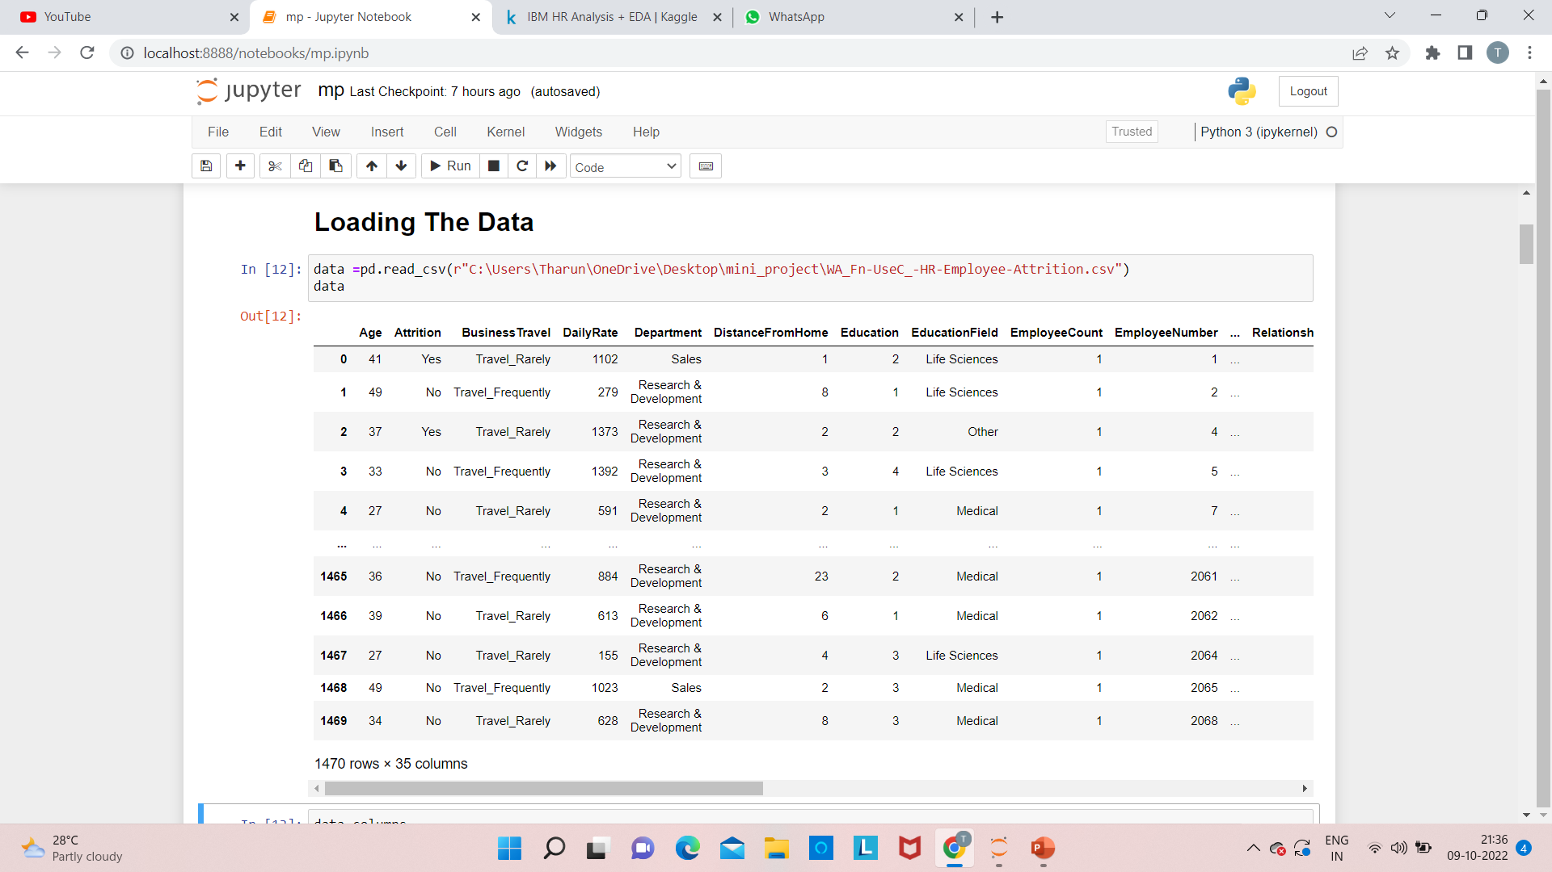
MODULE - I

Slide 11
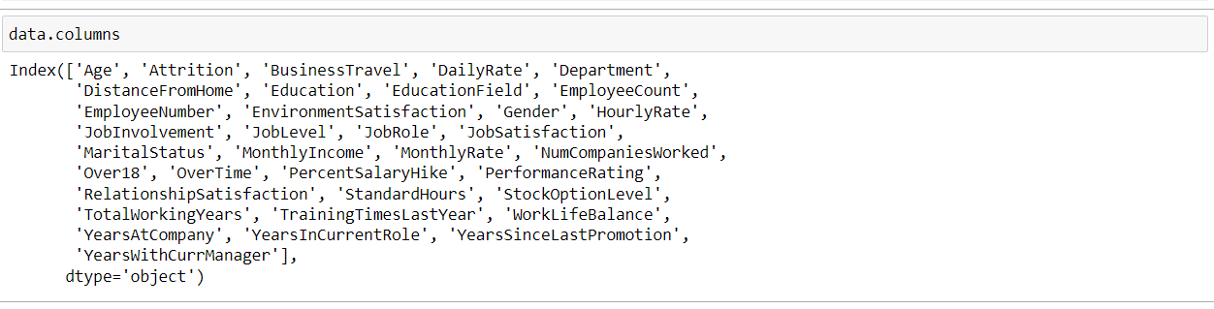
MODULE – I
FEATURES :

Slide 12
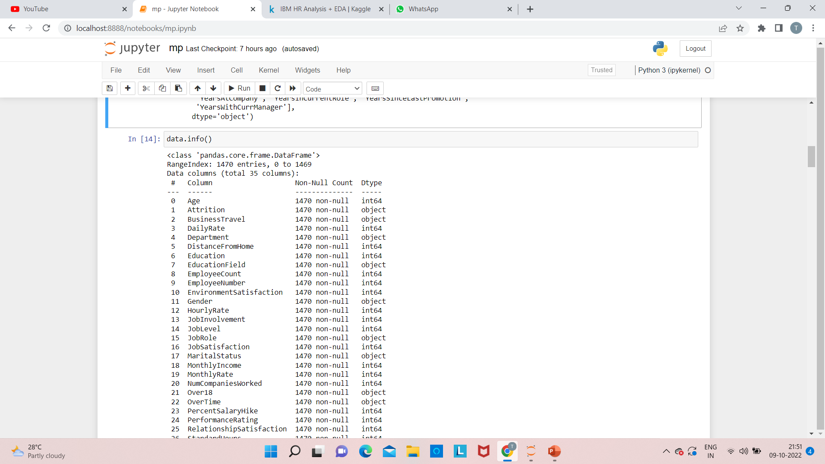
MODULE – I

Slide 13
MODULE – II
DATA PREPARATION
We check for the presence of any null values or duplicate values.
1)Null values present in the dataset may alter the accuracy of the prediction.
2)Duplicate values present in the data occupies more space and
May provide incorrect prediction.

Slide 14
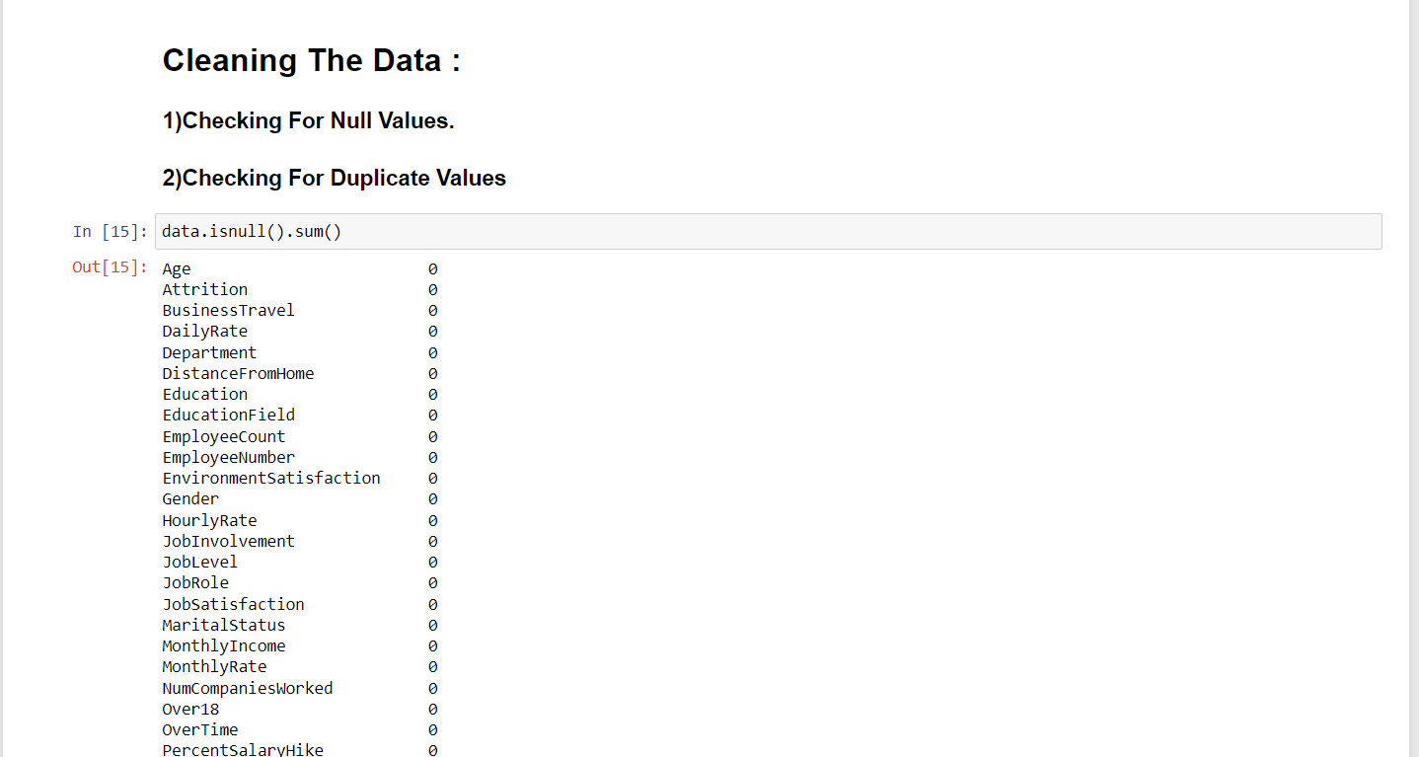
MODULE – II

Slide 15
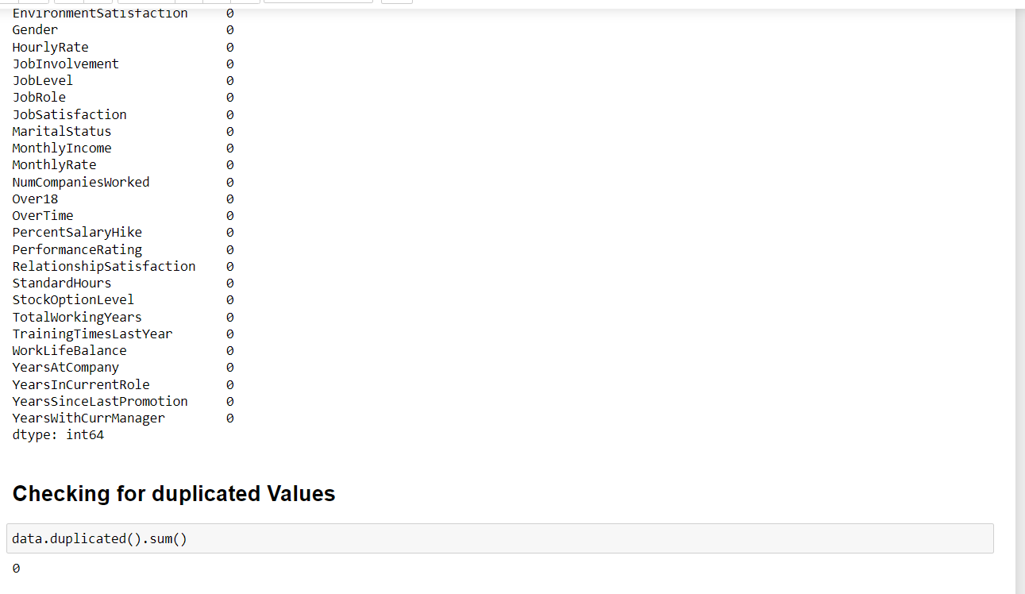
MODULE – II

Slide 16
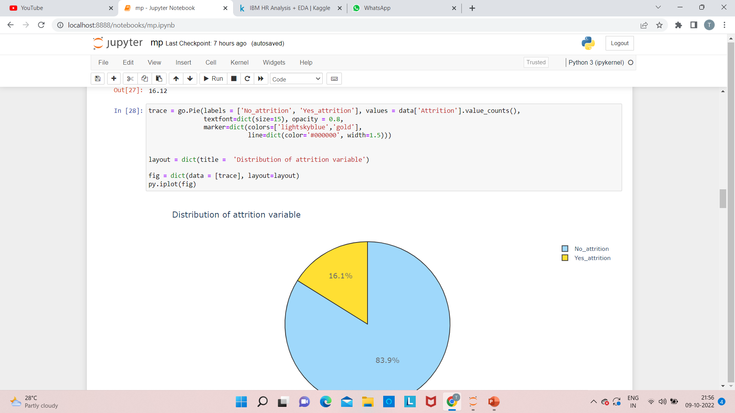
MODULE – III
Exploratory Data Analysis

Slide 17
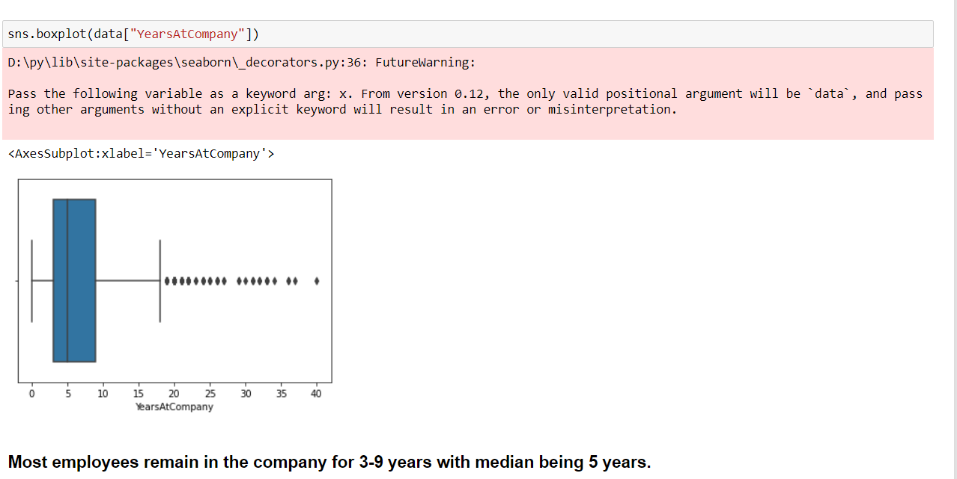
MODULE – III

Slide 18
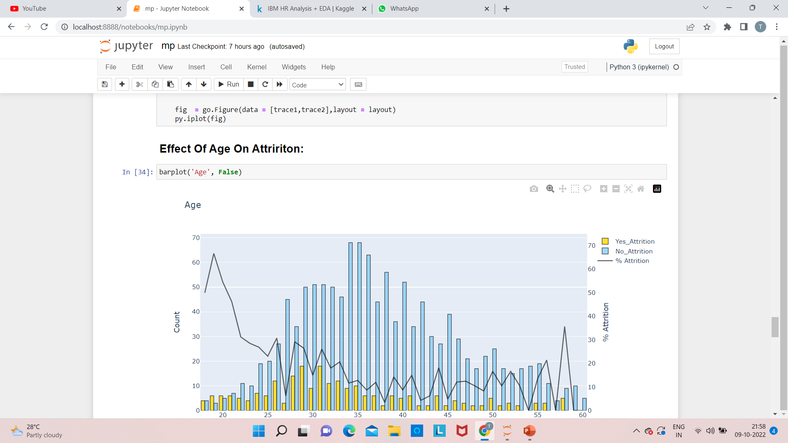
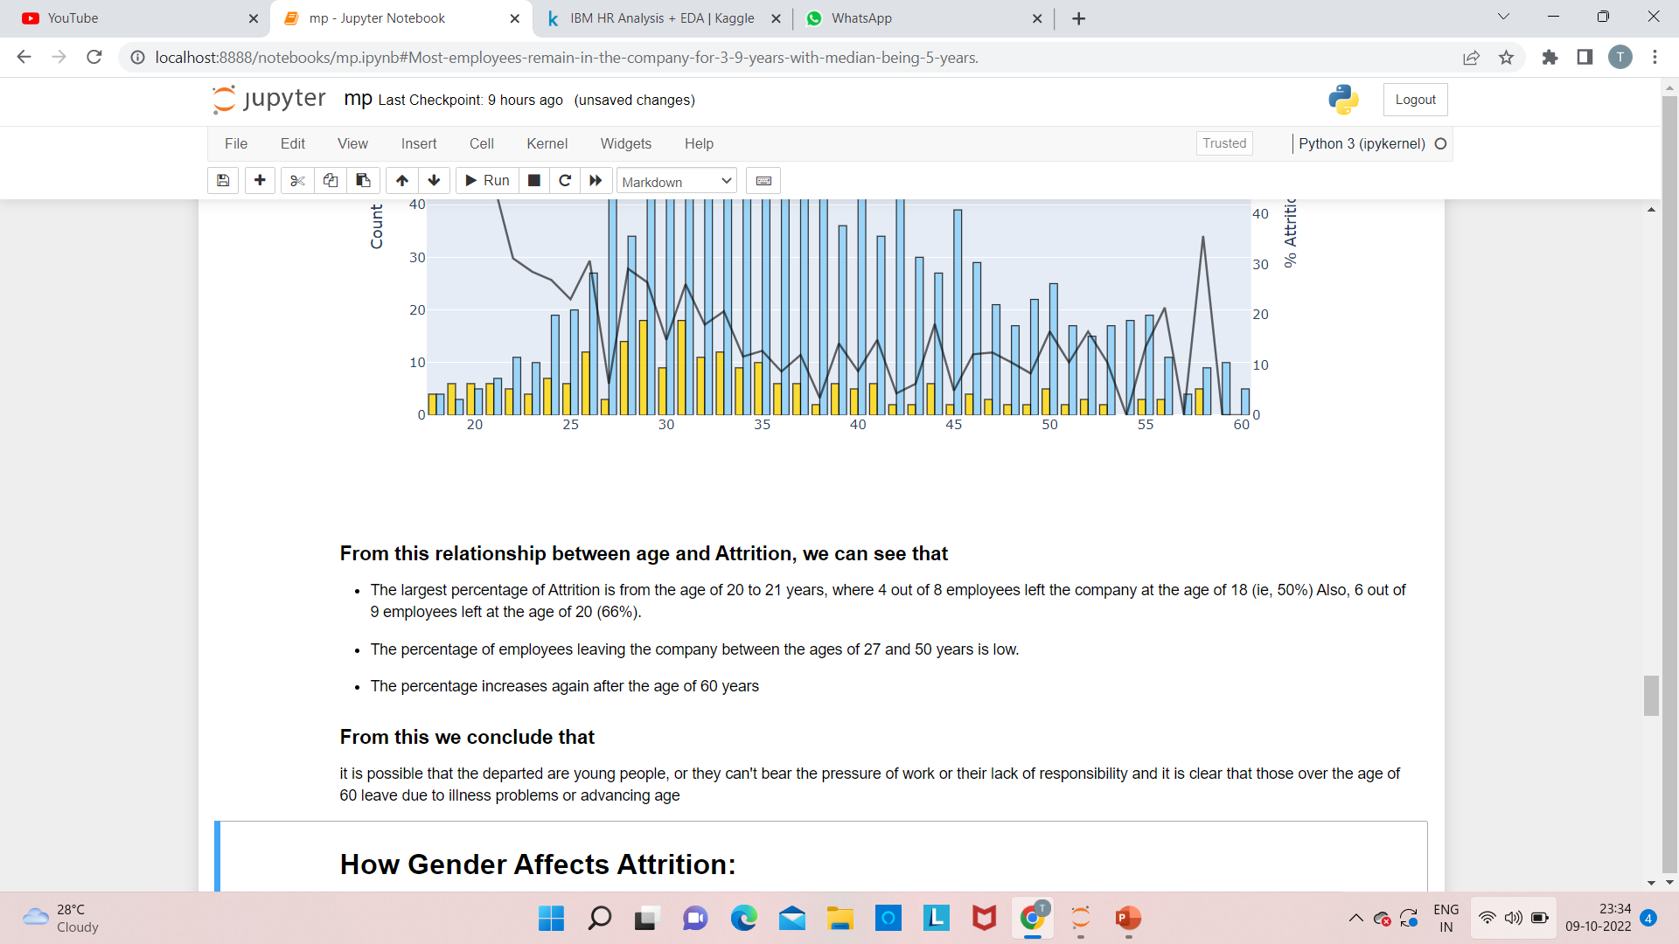
MODULE – III

Slide 19
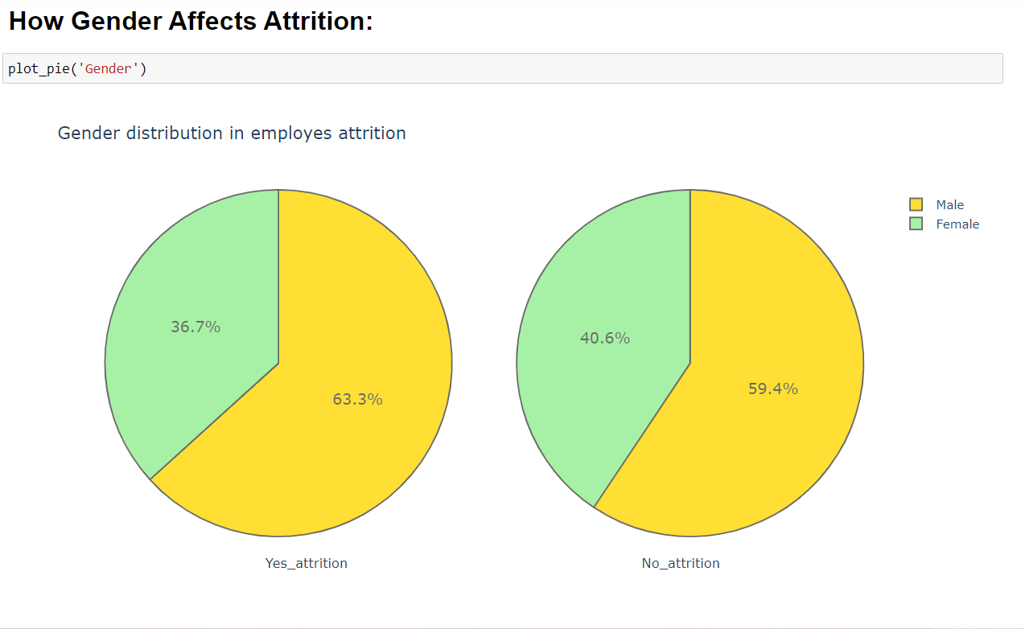
MODULE – III

Slide 20
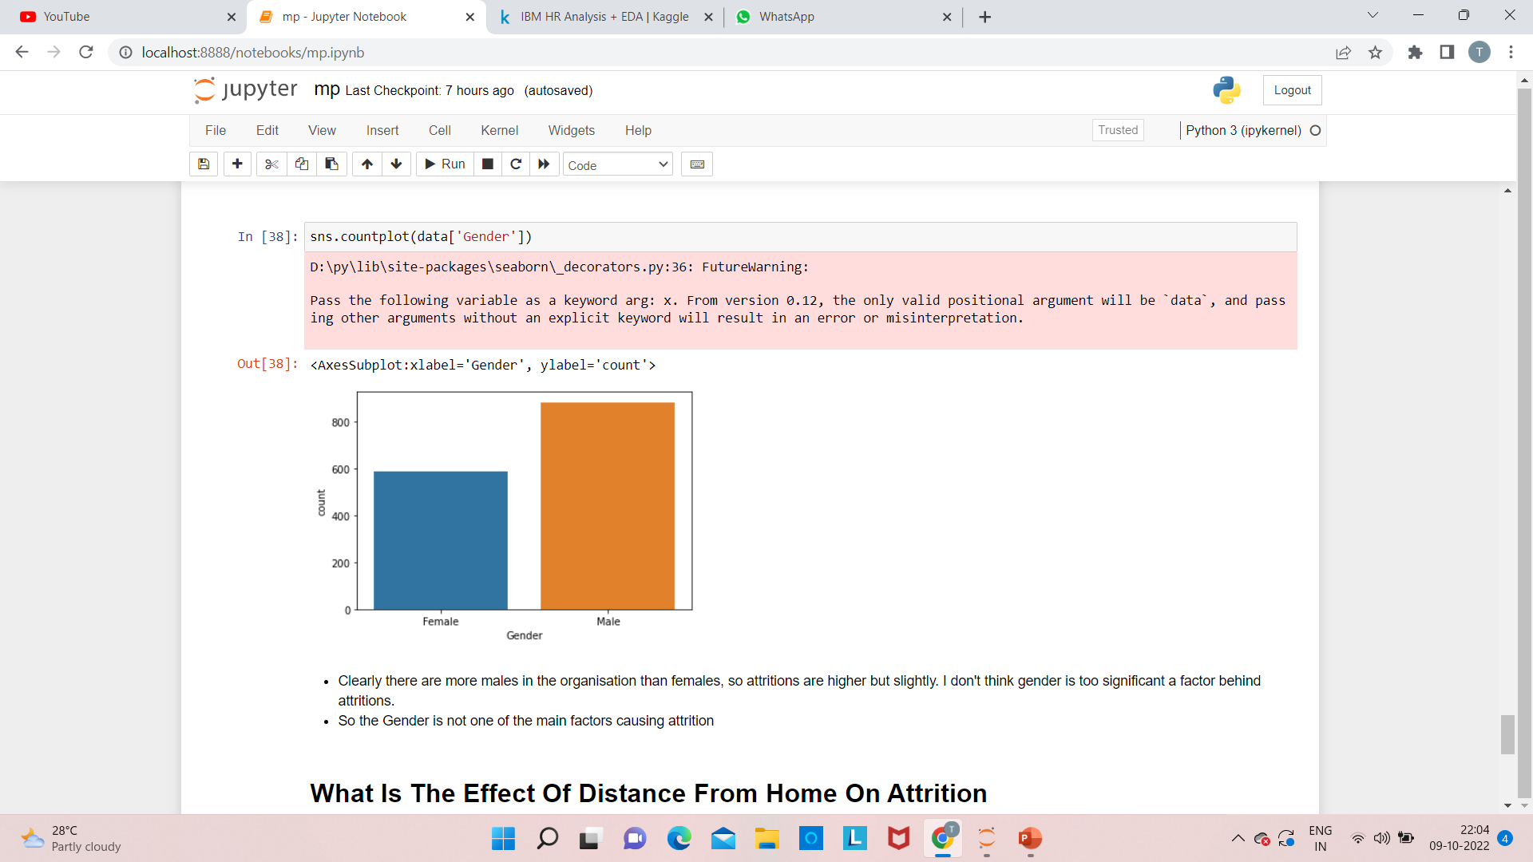
MODULE – III

Slide 21
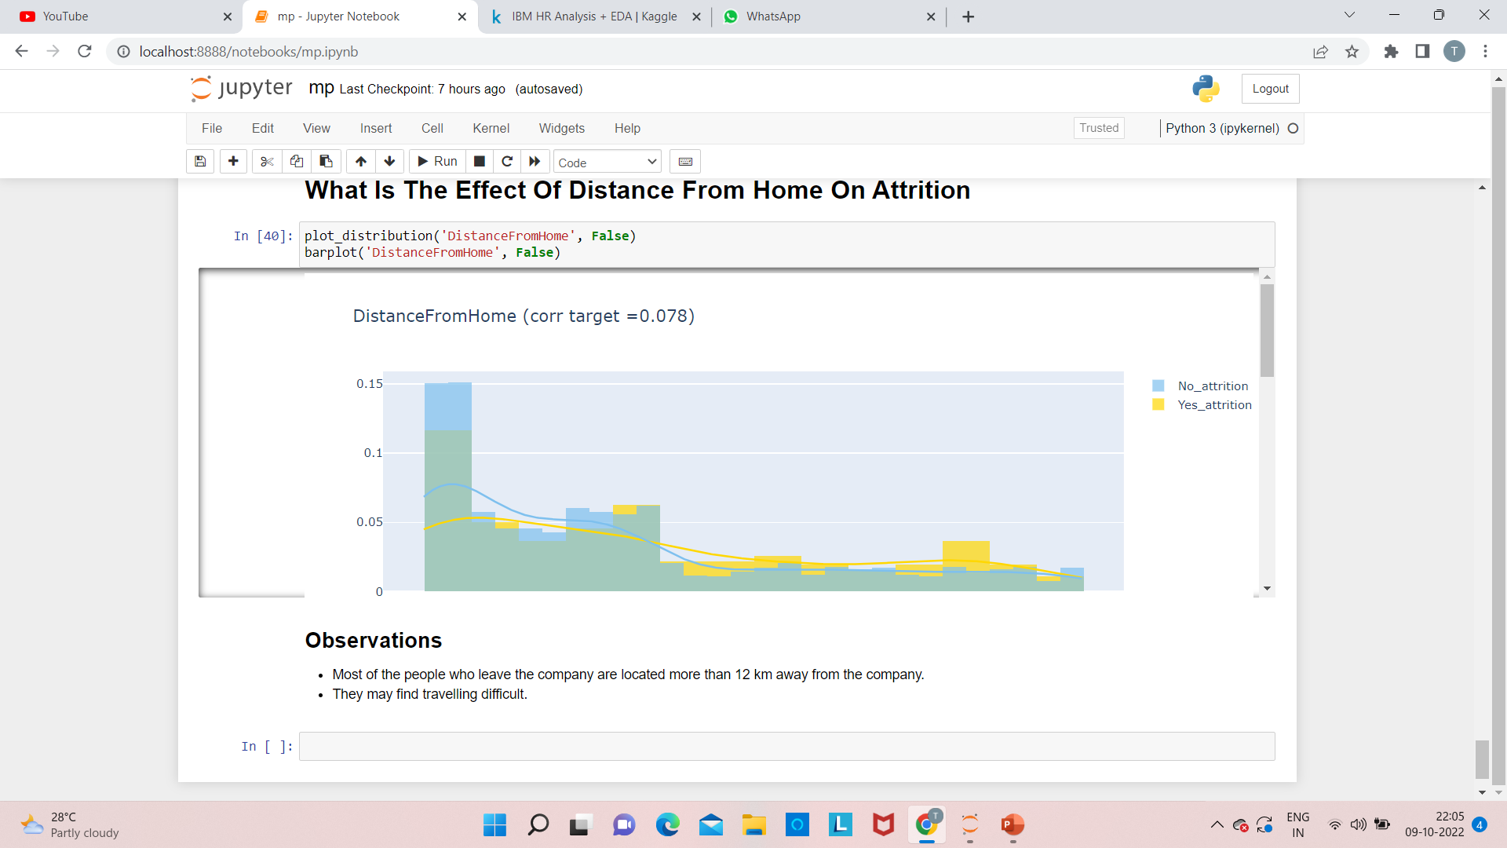
MODULE – III

Slide 22
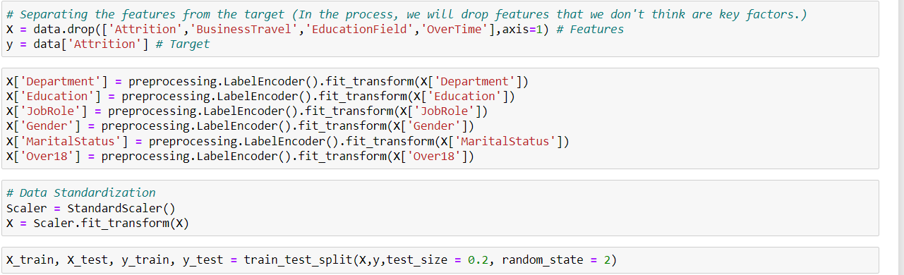
MODULE – IV
MODEL BUILDING

Slide 23
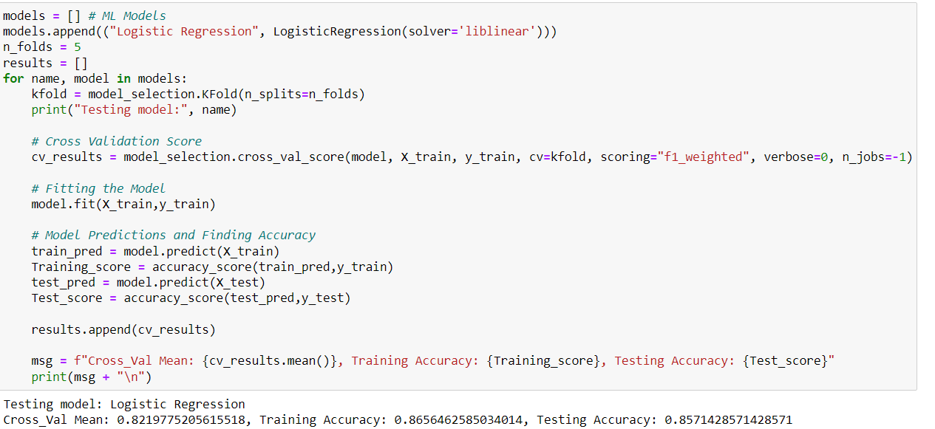
MODULE – IV
MODEL BUILDING

Slide 24
SYSTEM REQUIREMENTS
HARDWARE REQUIREMENTS :
4 GB RAM (Minimum)
80 GB HDD.
Dual Core processor.
SOFTWARE REQUIREMENTS :
Python
Pandas
Matplotlib
Jupyter Notebook

Slide 25
REFERENCES
[1] R. Punnoose and P. Ajit, ‘‘Prediction of employee turnover in organizations using machine learning algorithms,’’ Int. J. Adv. Res. Artif. Intell., vol. 5, no. 9, p. 5, 2016, doi: 10.14569/IJARAI.2016.050904.
[2] R. Colomo-Palacios, C. Casado-Lumbreras, S. Misra, and P. Soto-Acosta, ‘‘Career abandonment intentions among software workers,’’ Hum. Factors Ergonom. Manuf. Service Industries, vol. 24, no. 6, pp. 641–655, Nov. 2014, doi: 10.1002/hfm.20509.
[3] Amazon.fr—People Analytics in the era of big Data: Changing the way you Attract, Acquire, Develop, and Retain Talent—Jean Paul Isson—Livres. Accessed: Dec. 15, 2019. [Online]. Available: https://www.amazon.fr/People-Analytics-Era-Big-Data/dp/1119050782 .
[4] D. Angrave, A. Charlwood, I. Kirkpatrick, M. Lawrence, and M. Stuart, ‘‘HR and analytics: Why HR is set to fail the big data challenge,’’ Hum. Resource Manage. J., vol. 26, no. 1, pp. 1–11, Jan. 2016, doi: 10.1111/1748-8583.12090

Slide 26
Decision Tree, Random Forest, Logistic Regression and Support Vector Machine

